Slide 1

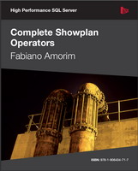


I’m a DBA, now what? Tips and tricks for new DBAs
PS: I’m from Brazil that’s why I’m speaking portuglish
SELECT "About me:"
FROM (VALUES('Fabiano Neves Amorim'),
('SQL Server MVP'),
('fabiano_amorim@bol.com.br | @mcflyamorim'),
('Database consultant – Pythian(Love your data)'),
('http://blogfabiano.com')) AS Tab("About me:")

Slide 2
Agenda
Reducing mistakes– FIT-ACER by Pythian
Learn PowerShell
The DBA Tool belt and scripts folder
Apps
Scripts

Slide 3
When you notice you ran an update without the where clause...
From http://dbareactions.com/

Slide 4
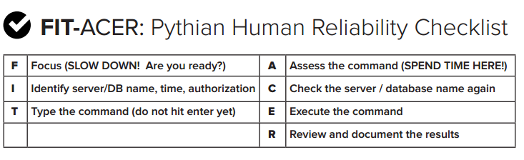
FIT-ACER – Reduce mistakes
Pythian FIT-ACER may help you... Use it!
http://www.pythian.com/blog/how-toreduce-mistakes-when-managing-a-database/
SSMS – Custom colors
Demo

Slide 5

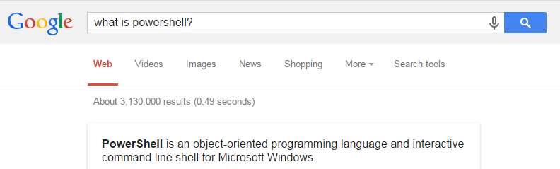

Learn powershell
https://www.simple-talk.com/author/laerte-junior/
Small sample of a nice script... (top 10 largest files)
Demo

Slide 6


Utility tool belt
Some tools make life easier
Better sample of tool belt, I mean, aaa you got the idea ☺

Slide 7
Utility tool belt
SQLQueryStress
http://www.datamanipulation.net/sqlquerystress/
Windows Performance Toolkit
Windows Performance Recorder and Windows Performance Analyzer
http://go.microsoft.com/fwlink/p/?LinkID=293840
ClearTrace
http://www.scalesql.com/cleartrace/
SQL Sentry Plan Explorer
https://www.sqlsentry.com/products/plan-explorer/sql-server-query-view
SQL Search
http://www.red-gate.com/products/sql-development/sql-search/
Performance Analysis of Logs (PAL) Tool
https://pal.codeplex.com/
SQLIO
http://www.microsoft.com/en-us/download/details.aspx?id=20163
AgentRansack
http://www.mythicsoft.com/agentransack
ZoomIt
http://technet.microsoft.com/pt-pt/sysinternals/bb897434.aspx
Profiler, perfmon, resource monitor, sysinternals...

Slide 8
Scripts
SP_WhoIsActive
http://sqlblog.com/files/folders/beta/entry42453.aspx
SQL Server Diagnostic Information Queries – Gleen Berry
https://sqlserverperformance.wordpress.com/category/diagnostic-queries/
SQL Server Index and Statistics Maintenance – Ola Hallengren
https://ola.hallengren.com/sql-server-index-and-statistics-maintenance.html
SP Blitz – Brent Ozar
http://www.brentozar.com/blitz/
Fusion IO
http://sourceforge.net/projects/mssqlserverscri/

Slide 9

Thank you!
SELECT "About me:"
FROM (VALUES('Fabiano Neves Amorim'),
('SQL Server MVP'),
('fabiano_amorim@bol.com.br | @mcflyamorim'),
('Database consultant – Pythian (Love your data)'),
('http://blogfabiano.com')) AS Tab("About me:")
?

